Slide 1
Chapter 8 Searching and Sorting Arrays

Slide 2
Searching and Sorting
We often need to search an array for a specific item.
We often need to sort an array (from highest to lowest, into alphabetical order, and so on).
There are many algorithms for searching and sorting.
You could probably think of ways to write your own original programs to search or sort but you should also know how to evaluate algorithms that are available for a task and be able to select which best serves your purpose in a given situation.

Slide 3
8.1 The Serial Search Technique
Steps:
Load, or populate, the arrays.
Identify the key (the item to locate).
Search the array that contains the key to find a match.
Display the key and corresponding values in the non-key arrays with the same subscript as the one with the key value, if a match is found.
Display an “unsuccessful search” message if no matches are found.

Slide 4
Use a Flag
Use a flag, or switch, to decide which message to print.
A flag is a Boolean variable that is set to 0 or 1 (true or false), depending on the results of an operation.
The value of the flag can be checked later in the program with an If statement to determine which action to take.

Slide 5
General Pseudocode for the Serial Search
//Set the subscript (Index) of the current key to 0
Set Index = 0
//Set a flag (Found) to 0
Set Found = 0
While (Found == 0) AND (Index < N)
If KeyData[Index] == Key Then
Set Found = 1
End If
Set Index = Index + 1
End While
If Found == 1 Then
Write KeyData[Index – 1]
Else
Write “The item you are searching for was not found.”
End If

Slide 6
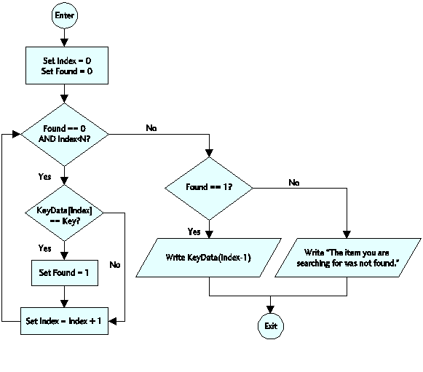
Flowchart for the Serial Search

Slide 7
Example: Searching and Parallel Arrays
This program segment displays the test score for a particular student when the student’s identification number is input by the user.
It searches an array, IDNumbers, which consists of identification numbers for the ID number input (IDKey).
Then it does the following:
Displays the corresponding student name and test score contained in two parallel arrays named Names and Scores, if the number IDKey is found in the IDNumbers array or…
Displays an appropriate message if the IDKey is not found in the IDNumbers array
Pseudocode is on next slide.
Assume that the arrays IDNumbers, Names, and Scores have already been declared and loaded with the necessary data.
Assume that the number of elements in each of these parallel arrays is N, the variables IDKey, and Index, have been declared as Integer variables, and Found has been declared as a Boolean variable.

Slide 8
Example: Searching and Parallel Arrays
1 Write “Enter a student ID number: “
2 Input IDKey
3 Set Index = 0
4 Set Found = 0
5 While (Found == 0) AND (Index < N)
6 If IDNumbers[Index] == IDKey Then
7 Set Found = 1
8 End If
9 Set Index = Index + 1
10 End While
11 If Found == 0 Then
12 Write “Student ID not found”
13 Else
14 Write “ID Number: “ + IDKey
15 Write “Student name: “ + Names[Index – 1]
16 Write “Test score: “ + Scores[Index – 1]
17 End If

Slide 9
8.2 The Bubble Sort Technique
To sort data means to arrange it in a particular numerical or alphabetical order, ascending or descending.
To sort small amounts of data, use the bubble sort technique.
Make several passes through the data.
Compare adjacent pairs of data.
If the pairs are not in order, swap them.
Continue until all data is processed.

Slide 10
Swapping Values
To swap two values, you must store one of them in a temporary storage location while you make the swap.
To interchange array elements Array[K] and Array[K + 1], the pseudocode for the swap looks like this:
Set Temp = Array[K]
Set Array[K] = Array[K + 1]
Set Array[K + 1] = Temp
Walk through the swap routine with a few values to see how it works.
If Array[K] = 6 and Array[K + 1] = 18 at first, after the swap:
Array[K] will contain the value 18
Array[K + 1] will contain the value 6
What will be the value in Temp?

Slide 11
Swap Example: The shirt can be either yellow or green and the logo can be either black or red. (assumption: only the 4 colors specified are entered but may be in incorrect order)
1 Write “Pick two colors: either yellow or green and either red or black.“
2 Write “Enter your first color: “
3 Input Shirt
4 Write “Enter your second color: “
5 Input Logo
6 If (Shirt != “yellow”) OR (Shirt != “green”) Then
7 Set Temp = Shirt
8 Set Shirt = Logo
9 Set Logo = Temp
10 End If
11 Write “You have selected a “ + Shirt + “ shirt with a “
+ Logo + “ logo.”

Slide 12
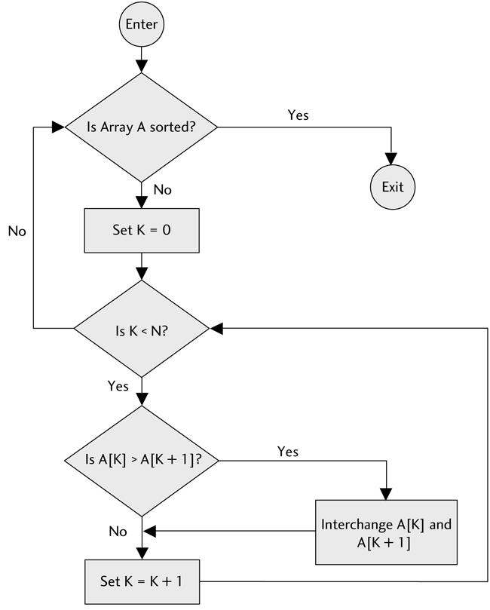
Flowchart for the Bubble Sort

Slide 13
General Pseudocode for the Bubble Sort
Given an array, A, with N elements:
While (array A is not sorted)
For (K = 0; K < N – 1; K++)
If A[K] > A[K + 1] Then
Interchange A[K] and A[K + 1]
End If
End For
End While
The maximum number passes needed to sort N numbers is N – 1 but may be less. A flag is used to exit the array when all elements are sorted.

Slide 14
Example: Input numbers in any order and sort them
1 Declare TestScores[100] As Float
2 Declare Count, K As Integer
3 Declare Flag As Boolean
4 Declare OneScore, Temp As Float
5 Write “Enter a test score; enter –9999 when done: “
6 Input OneScore
7 Set Count = 0
8 While OneScore != –9999
9 Set TestScores[Count] = OneScore
10 Set Count = Count + 1
11 Write “Enter a test score; enter –9999 when done: “
12 Input OneScore
13 End While(OneScore)
14 Set Flag = 0
15 While Flag == 0
16 Set Flag = 1; Set K = 0
17 While K <= (Count – 2)
18 If TestScores[K] < TestScores[K + 1] Then
19 Set Temp = TestScores[K]
20 Set TestScores[K] = TestScores[K + 1]
21 Set TestScores[K + 1] = Temp
22 Set Flag = 0
23 End If
24 Set K = K + 1
25 End While(K)
26 End While(Flag)
27 Write “Sorted list...”
28 Set K = 0
29 While K <= (Count – 1)
30 Write TestScores[K]
31 Set K = K + 1
32 End While(K)

Slide 15
8.3 The Binary Search
The binary search method is a good way to search a large amount of data for a particular item.
That item is called the search key.
The binary search works better for large amounts of data than the serial search.
The binary search is:
more efficient than the serial search technique
requires that the table keys, the array of data to be searched, is in numerical or alphabetical order

Slide 16
General Process for the Binary Search
First compare the search key (the target) to the table key midway through the given array.
Because the array data is ordered, it is possible to see in which half of the array the search key lies.
Then compare the search key to the table key in the middle of this half.
This determines in which quarter of the array the search key is located.
Then look at the middle entry in this quarter.
Continue this process until search key is found.

Slide 17
General Pseudocode for Binary Search
1 Declare Low, High, N, Index As Integer
2 Declare Found As Boolean
3 Set Low = 0
4 Set High = N
5 Set Index = Int(N/2)
6 Set Found = 0
7 While (Found == 0) AND (Low <= High)
8 If Key == Array[Index] Then
9 Set Found = 1
10 End If
11 If Key > Array[Index] Then
12 Set Low = Index + 1
13 Set Index = Int((High + Low)/2)
14 End If
15 If Key < Array[Index] Then
16 Set High = Index – 1
17 Set Index = Int((High + Low)/2)
18 End If
19 End While

Slide 18
Combining Parallel Arrays and a Binary Search
Professor Crabtree saves all her student records in parallel arrays.
The array Names holds the students’ names, listed alphabetically by last name.
Each time she gives an exam or grades a homework assignment, she adds a new parallel array: Exam1, Exam2, HW1, HW2, and so on.
Now Dr. Crabtree wants to be able to locate the record for one specific student.
The pseudocode on the next slide assumes the following parallel arrays have been declared, filled with data, and that the following variables have been declared:
Names[100] is an array of Strings with each element holding a student’s last name
First[100] is an array of Strings with each element holding a student’s first name
Exam1[100], HW1[100], and HW2[100] are parallel arrays of Floats.
Low, High, N, and Index are Integer variables.
Found is a Boolean variable.
Student is a String variable.

Slide 19
Professor Crabtree’s pseudocode
1 Set N = 99, Set Low = 0, Set High = N
2 Set Found = 0
3 Set Index = Floor(N/2)
4 Write “Enter a student’s name: “
5 Input Student
6 While (Found == 0) AND (Low <= High)
7 If Student < Names[Index] Then
8 Set High = Index – 1
9 Set Index = Floor((High + Low)/2)
10 Else
11 If Student > Names[Index] Then
12 Set Low = Index + 1
13 Set Index = Floor((High + Low)/2)
14 Else
15 Set Found = 1
16 End If
17 End If
18 End While
19 If Found == 0 Then
20 Write “Student record not found.”
21 Else
22 Write “Student record for: “
23 Write First[Index] + “ “ + Names[Index]
24 Write “Exam 1: “ + Exam1[Index]
25 Write “Homework 1: “ + HW1[Index]
26 Write “Homework 2: “ + HW2[Index]
27 End If

Slide 20
8.4 The Selection Sort
The selection sort procedure is a more efficient way to sort data stored in an array than the bubble sort.
Basic idea:
On 1st pass, locate the smallest array element and swap it with the first array element.
On 2nd pass, locate the second smallest element and swap it with the second element of the array.
On the 3rd pass, locate the next smallest element and swap it with the third element of the array and so forth...
If the array contains N elements, it will be completely sorted after, at most,
N – 1 passes.

Slide 21
General Pseudocode for the Selection Sort
1 Declare Array[K] As Float
2 Declare Littlest As Float
3 Declare K, N, Index, Temp As Integer
4 For (K = 0; K < N; K++)
5 Set Littlest = Array[K]
6 Set Index = K
7 For (J = K + 1; J <= N; J++)
8 If Array[J] < Littlest Then
9 Set Littlest = Array[J]
10 Set Index = J
11 End If
12 End For(J)
13 If K != Index Then
14 Set Temp = Array[K]
15 Set Array[K] = Array[Index]
16 Set Array[Index] = Temp
17 End If
18 End For(K)

Slide 22
Applying the Selection Sort Technique
In this example assume we have an array that holds the ages of 200 students in Professor Crabtree’s classes. This program will sort the array in ascending order.
The pseudocode is on the following slide.
To save space we will assume:
Ages[200] is an array of Integers with each element holding the age of a student (in years).
Youngest, J, K, M, N, Temp and, Index are Integer variables.

Slide 23
Example: Use the selection sort to sort a large data set.
1 Set N = 199, Set M = 0, Set Temp = 0, Set K = 0
2 While K < N
3 Set Youngest = Ages[K]
4 Set Index = K
5 Set J = K + 1
6 While J <= N
7 If Ages[J] < Youngest Then
8 Set Youngest = Ages[J]
9 Set Index = J
10 End If
11 Set J = J + 1
12 End While(J)
13 If K != Index Then
14 Set Temp = Ages[K]
15 Set Ages[K] = Ages[Index]
16 Set Ages[Index] = Temp
17 End If
18 Set K = K + 1
19 End While(K)
20 Write “Ages sorted: “
21 While M < N + 1
22 Write Ages[M]
23 Set M = M + 1
24 End While(M)

